Slide 1

SCM MANAGER MEET

Slide 2
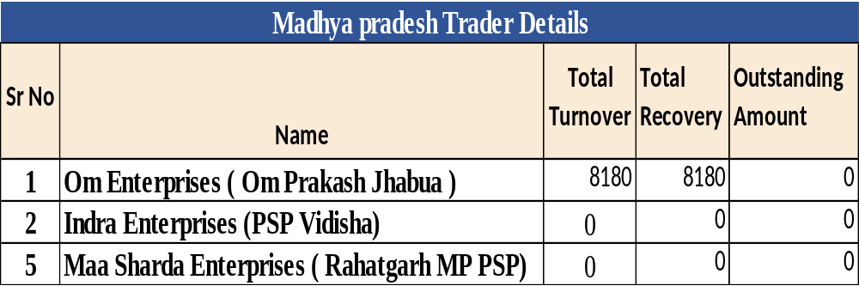
BUSINESS OF Central ZONE
May -2022

Slide 3
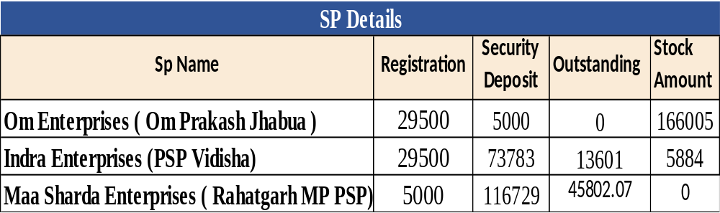
SP DETAILS

Slide 4
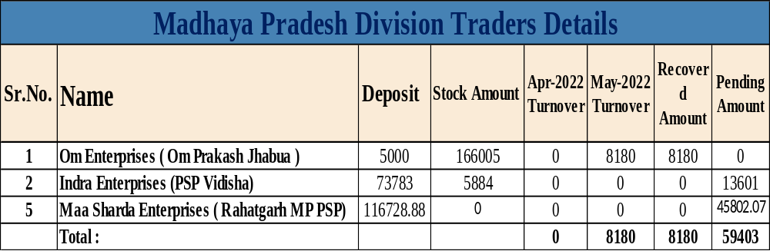
SP BUSINESS Analysis April- May 2022
Note : No Sales From April Month

Slide 5
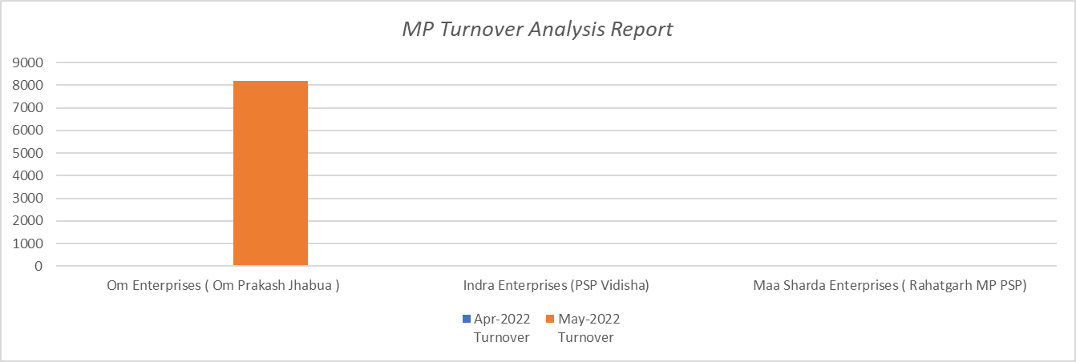
SP BUSINESS Analysis April- May 2022
Note : No Sales From April Month

Slide 6
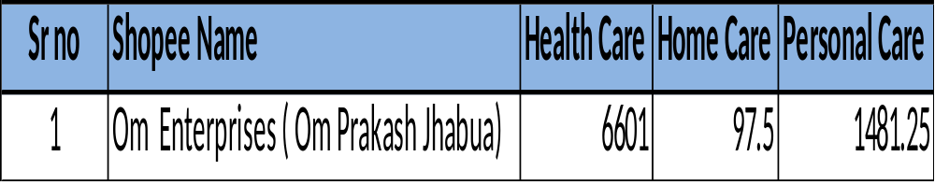
SP Product Wise Sales Report May 2022
Note : No Sales From April Month

Slide 7
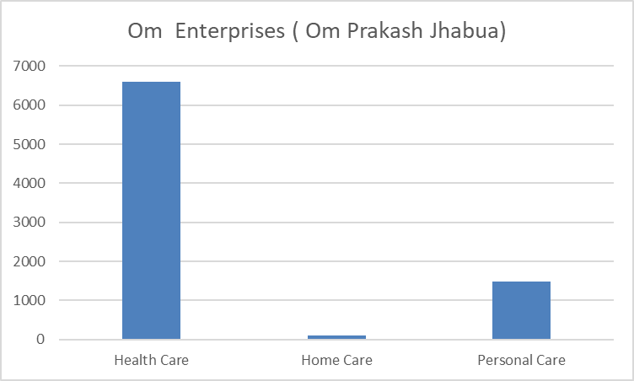
SP Product Wise Sales Report May 2022
Note : No Sales From April Month

Slide 8
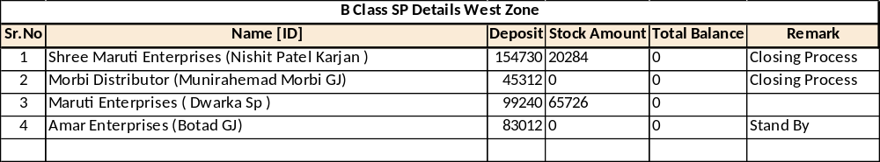
B Class SP Details

Slide 9
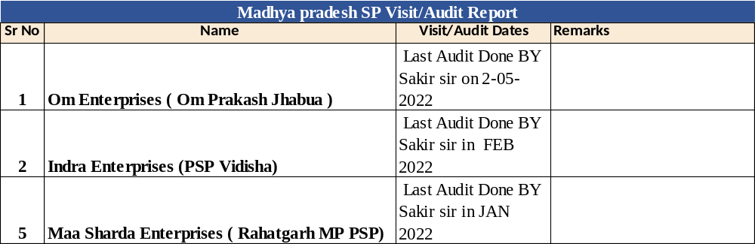
SP Visit/Audit Dates

Slide 10
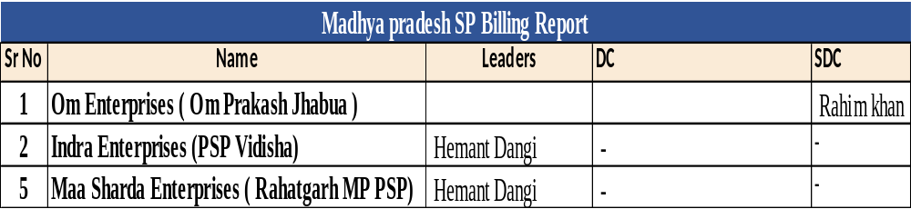
Leaders/DC/SDC doing billing at this SP

Slide 11
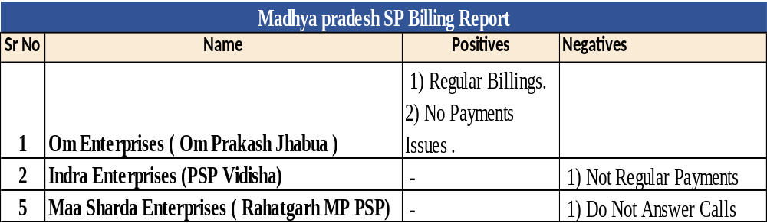
Positives & Negatives of SP

